Slide 1


Tiger Intrusion Detection System
By Team Tiger

Slide 2





Our Team
Atul Malhotra
Rejuan Ahammed Anik
Anik Sorkar
Hasibul AhasanShakil
Supervisor
Team Leader
Team Member
Team Member
ID : 18011
Registration: 11801114
Registration: 11816014
Registration: 11800440

Slide 3
What is Intrusion Detection System?
An Intrusion Detection System (IDS) is a monitoring system that detects suspicious activities and generates alerts when they are detected. Based upon these alerts, a security operations center (SOC) analyst or incident responder can investigate the issue and take the appropriate actions to remediate the threat.

Slide 4
Why we need Intrusion Detection System?
Modern networked business environments require a high level of security to ensure safe and trusted communication of information between various organizations. An intrusion detection system acts as an adaptable safeguard technology for system security after traditional technologies fail. Cyber attacks will only become more sophisticated, so it is important that protection technologies adapt along with their threats.

Slide 5
Types of Intrusion Detection System?
Network Intrusion Detection System (NIDS)
Host Intrusion Detection System (HIDS)
Protocol-based Intrusion Detection System (PIDS)
Application Protocol-based Intrusion Detection System (APIDS)
Hybrid Intrusion Detection System

Slide 6
Why we work on this project?
Available intrusion detection systems are good, but those are mostly expensive and can only detect some of the most serious threats to a computer system. They perform excellently in real-time, but their cost is too much that everyone cannot afford. So, we have introduced a framework to detect anomalies for the wireless network system. This will help to mitigate network anomalies. User will be able to configure the mode of sensibility as per their requirements which makes our framework more friendly and compatible to the users.

Slide 7
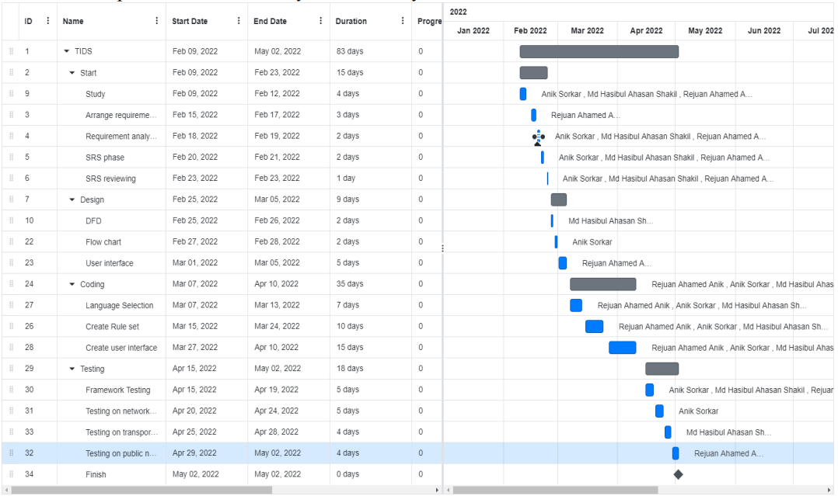
Project Plan

Slide 8
Our Framework will work For
Association / Authentication flooding.
Detect mass deauthentication which may indicate a possible WPA attack for handshake.
Detect possible WEP attack using the ARP request replay method.
Detect possible WEP attack using chopchop method.
Detect possible WPS pin bruteforce attack by Reaver, Bully, etc.
Detection of Evil-Twin.
Detection of Rogue Access Point.

Slide 9
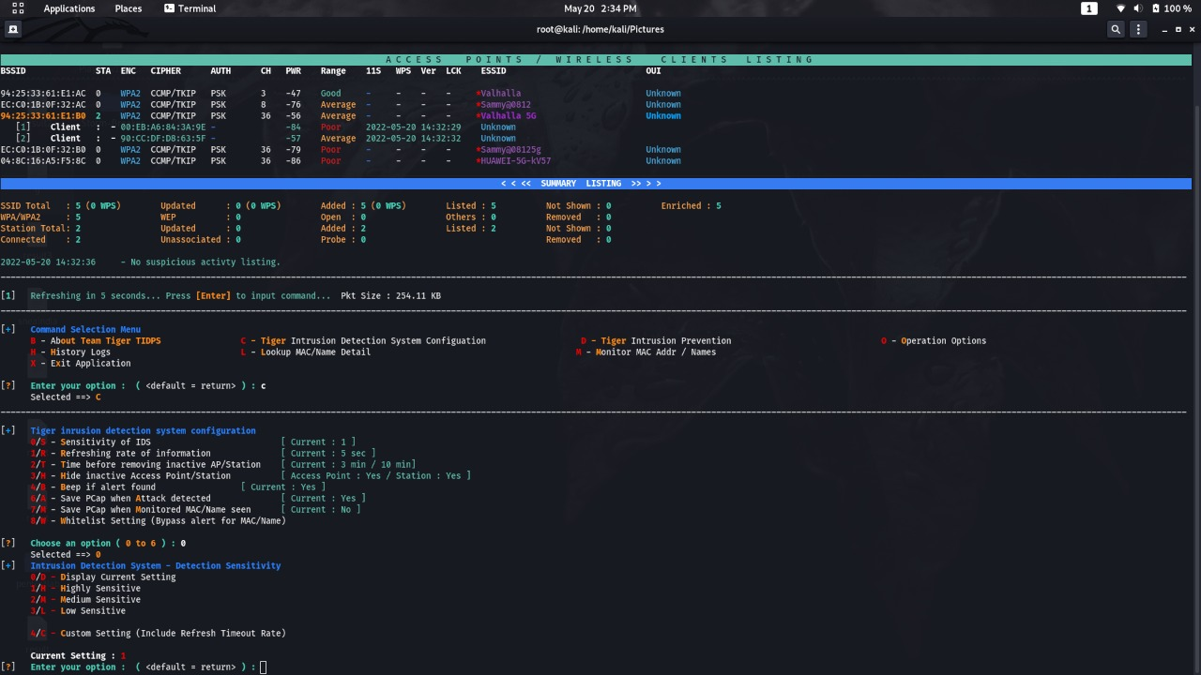
Interface Of Our Framework

Slide 10
Features Of Our Framework
Easy to use.
Live traffic monitoring system.
Detect various types of attack.

Slide 11
How our Framework work
Initializing monitoring mode.
Collecting information from BSSID & SSID.
Capturing Handshaking.

Slide 12
Supporting Tools
Air-crack ng
Kali Linux
Wifi-Adapter

Slide 13
Tiger Intrusion Detection System Configuration
High Sensitivity
Medium Sensitivity
Low Sensitivity
User Defence Sensitivity

Slide 14
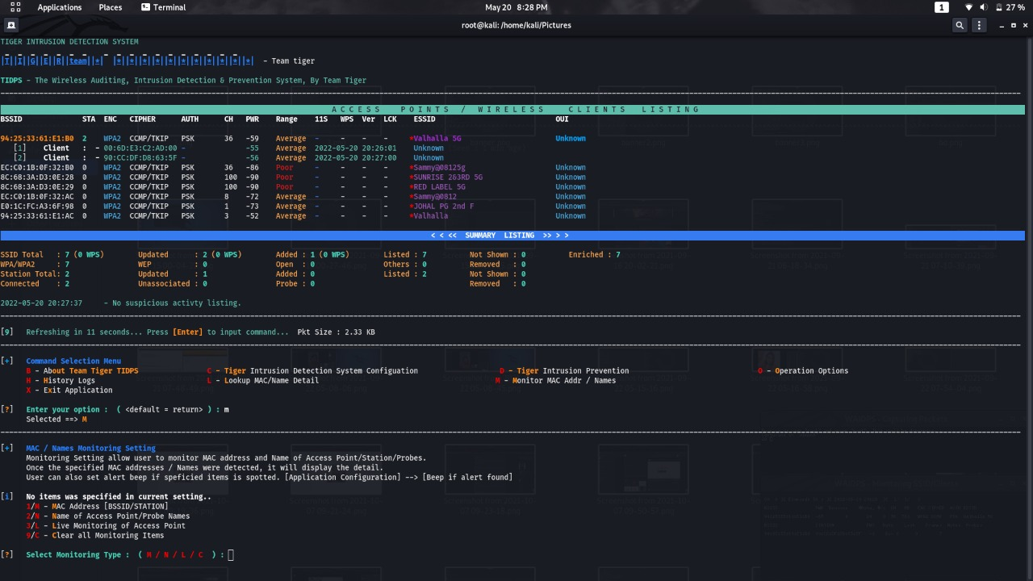
Mac Filtering

Slide 15
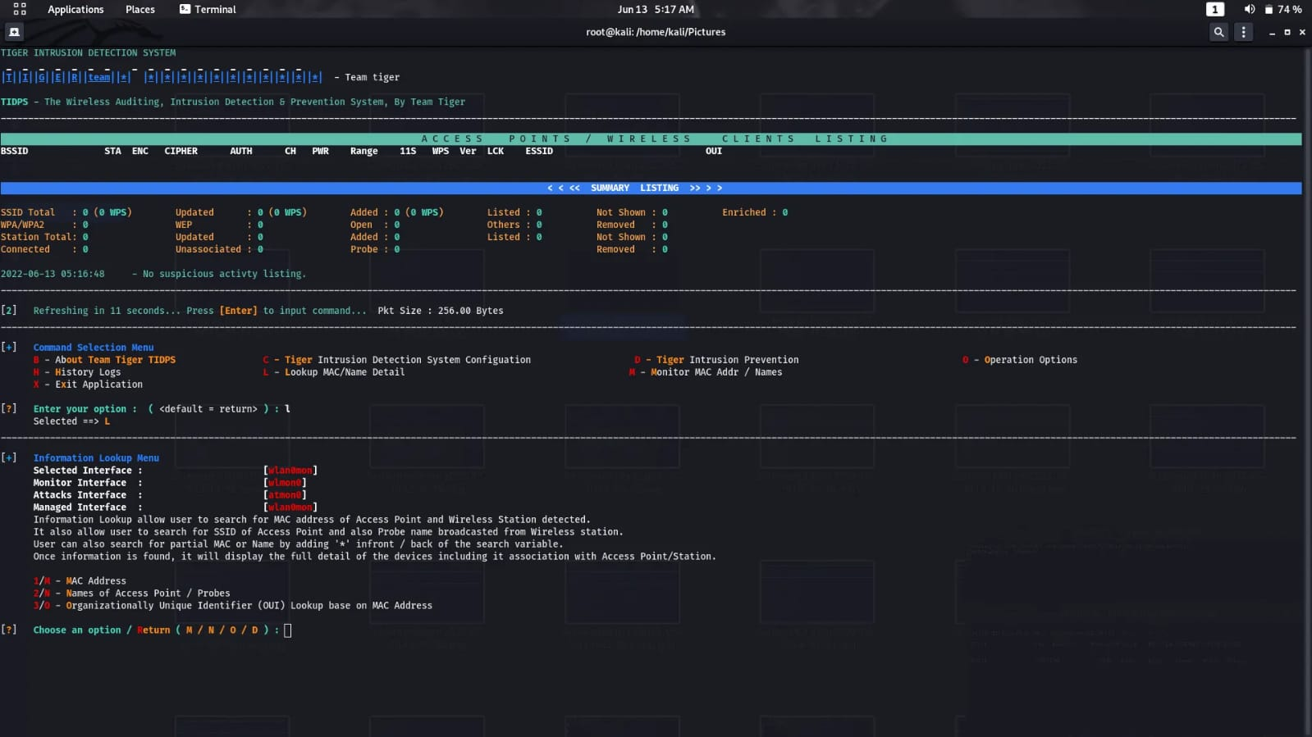
Mac Lookup

Slide 16
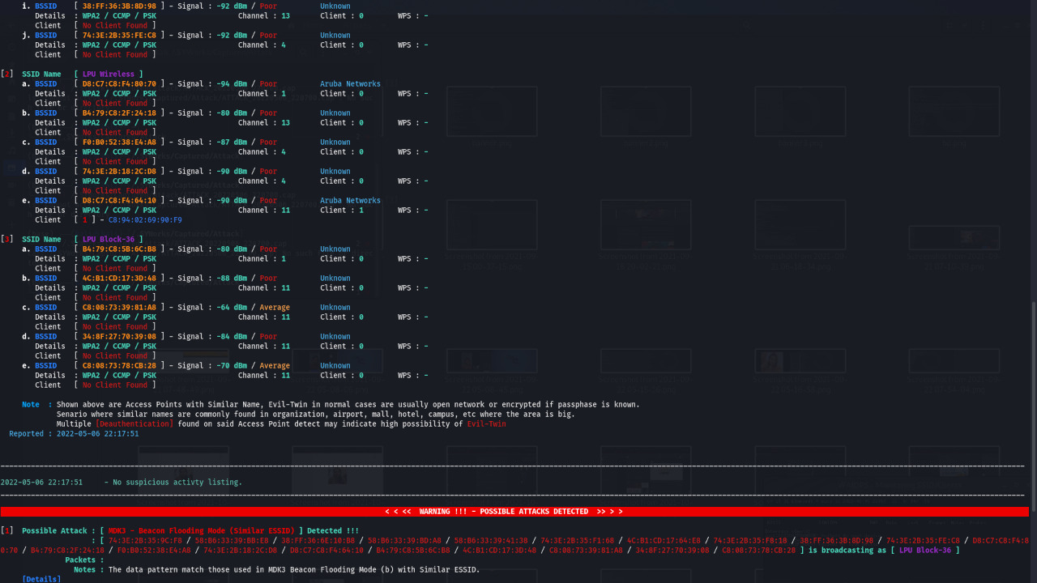
Detecting Attack At Public Network

Slide 17
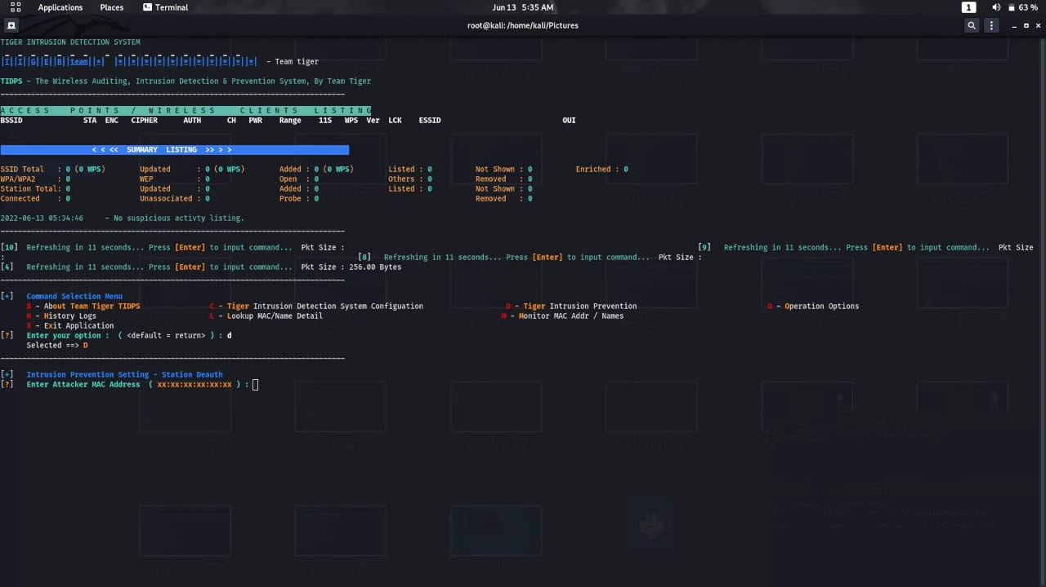
Prevention System

Slide 18
Future Plan
Always supported.
Artificial intelligence will be introduced.
GUI will be updated.

Slide 19
Thank You

